Slide 1
Weather detection
Hemant Koti & Vamshi Gujjari
CSE 4/510: Applied Deep Learning
Date: 08/12/2020

Slide 2
Topics for Discussion
Introduction
Objective
Description
Implementation
CNN Architecture
Transfer Learning
Flask Web Application
Demo
Deployment
Future work
References

Slide 3
Introduction

Slide 4
Objective
The objective of this project is to build a web app that classifies different weather conditions based on the images provided. ​
Our goal is to provide an economical and efficient solution to predict weather patterns from an image rather than relying on complex systems (sensors, satellites) used today.

Slide 5
Description
The dataset consists of images of 4 different weather conditions i.e., Sunrise, Rainy, Shine and Cloudy.
We will be running a deep convolution neural network on these images.
UI will accept an image from the user and sends it to the model, which returns the prediction.

Slide 6
Implementation

Slide 7
CNN Architecture
CONV1 - 64
MAXPOOL1
CONV2 - 128
MAXPOOL2
CONV3 - 128
CONV4 - 256
MAXPOOL3
CONV5 - 256
MAXPOOL4
CONV6 - 512
MAXPOOL5
FC1 - 512
FC2 - 4
Block

Slide 8
Flask Web Application
A flask web app is built on top of model generated from the CNN architecture.
The UI is built to accept an image from the user, which is resized to 224x224x3 and sent to the model.
The prediction is then presented to the user on the UI.
This web application is deployed on Google cloud platform.

Slide 9
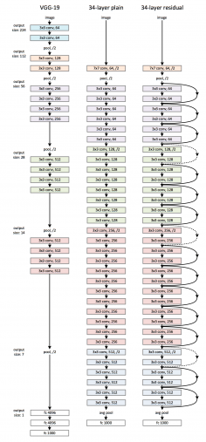
Transfer Learning with ResNet-34
Transfer learning outline
Load in a pre-trained CNN model trained on a large dataset
Freeze parameters (weights) in model’s lower convolutional layers
Add a classifier with several layers of trainable parameters to model
Train classifier layers on training data available for task
Fine-tune hyperparameters and unfreeze more layers as needed
Why we chose CNN over transfer learning?

Slide 10
Demo

Slide 11
Deployment

Slide 12
Google Cloud Deployment
Why Google Cloud?
Deployment process

Slide 13
Future Work

Slide 14
Future Work
Convolution Autoencoder for improved accuracy.
Model re-training in production.

Slide 15
References
Multi-class Weather Dataset for Image Classification
End to End Multiclass Image Classification Using PyTorch and Transfer Learning
Multiclass Image Classification with PyTorch | by Nandan Pandey | Analytics Vidhya | June 2020
Classification of Weather Images using ResNet-34 in PyTorch
GitHub link to this project
Deployed Application

Slide 16
Thank you
Questions?

